Slide 1
Econ 106
Lecture 14
slides derived from:
https://www.tidytextmining.com/tidytext

Slide 2
Reminders
Lab #4 is due Sunday 11:59pm
Please submit MS #2 by 11:59pm tonight if you haven’t already done so
Next week is Thanksgiving week:
in person lecture on Monday
Zoom lecture on Wednesday (or recording, I’ll let you know what I decide)

Slide 3
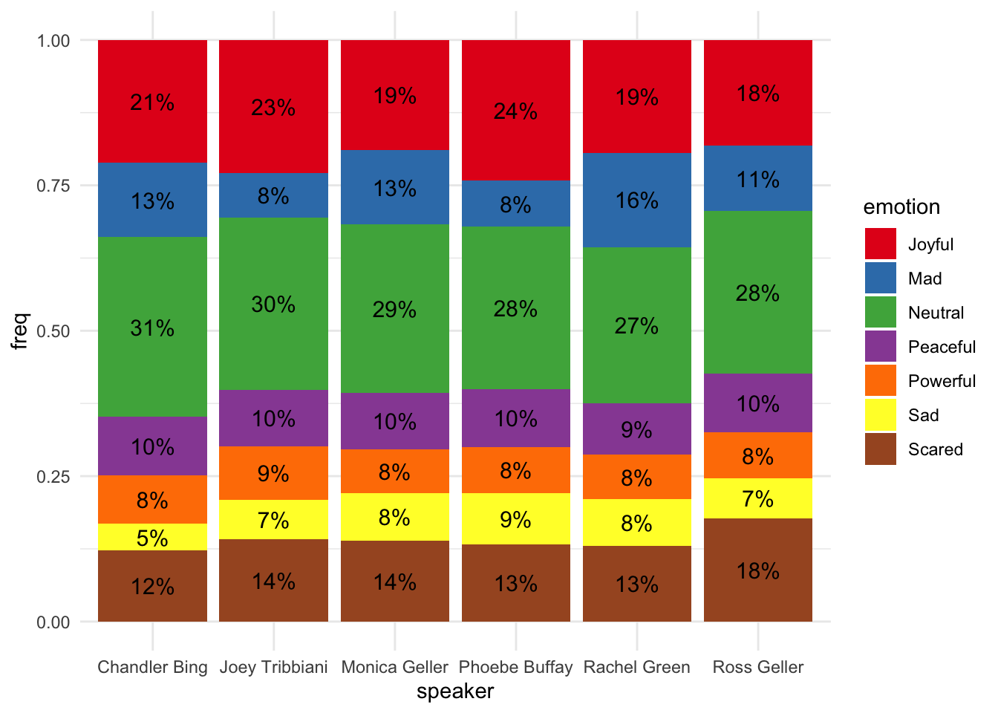
#tidytuesday
https://rpubs.com/Pyll/Friendship_is_magic

Slide 4
Outline
Text as Data:
sentiment analysis
word clouds

Slide 5
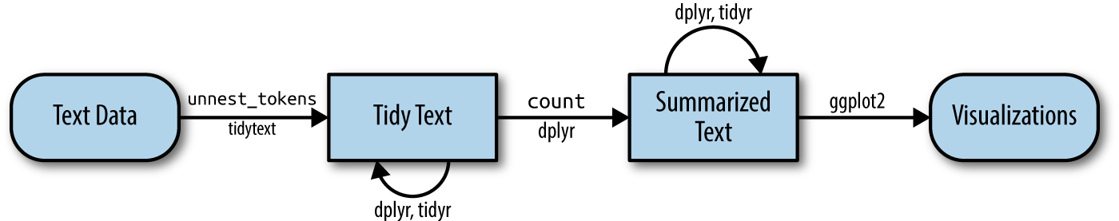
Overview of Text Analysis in R
https://www.tidytextmining.com/tidytext

Slide 6
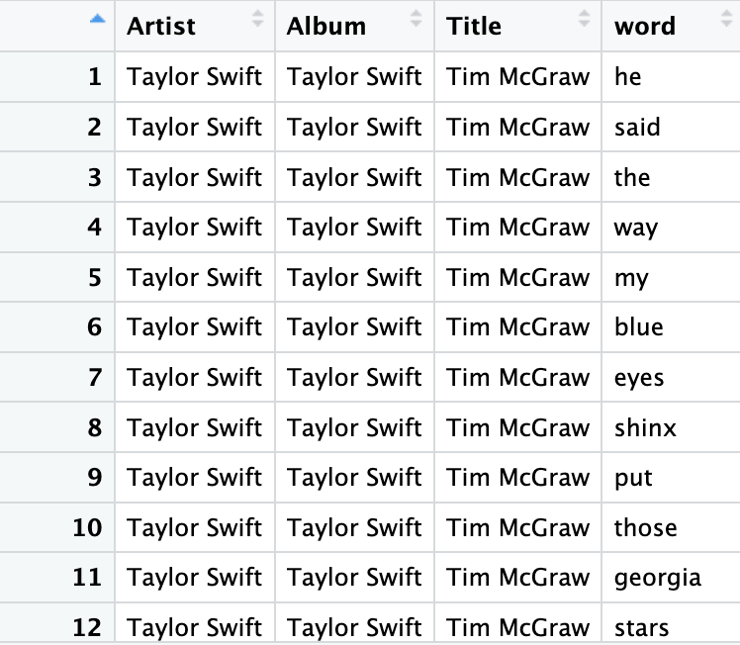
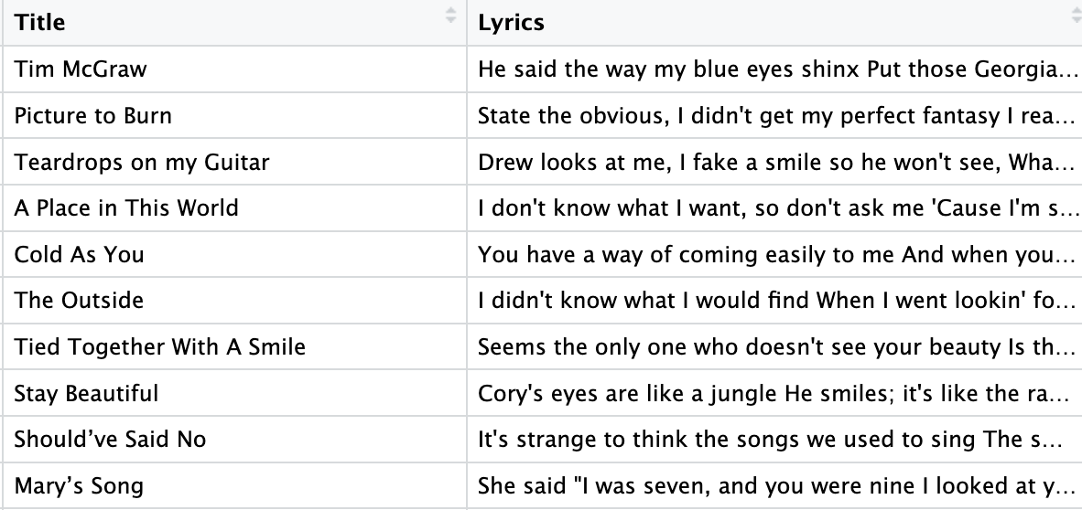
Step 1: Tokenize
tidy_lyrics <- taylor_swift_lyrics %>%
unnest_tokens(output=word, input=Lyrics)

Slide 7
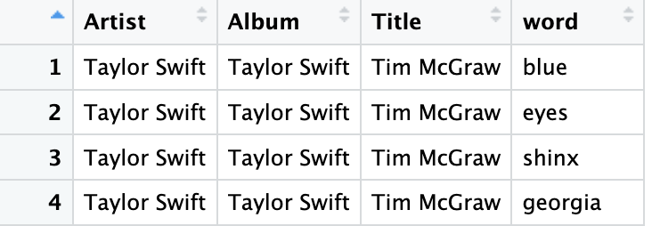
Step 2: Remove Stop Words
tidy_lyrics_no_stop <- anti_join(x=tidy_lyrics, y=stop_words)

Slide 8
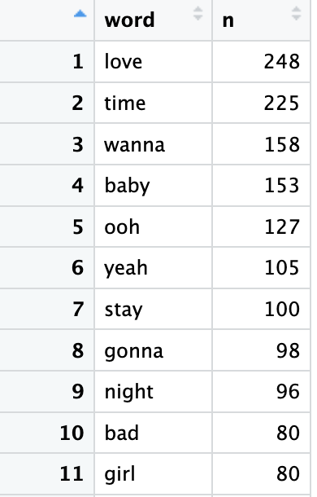
Step 3: Summarize (Count)
tidy_lyrics_top_ten<- tidy_lyrics_no_stop %>%
count(word) %>%
arrange(desc( n)) %>%
slice_head(n=10)

Slide 9
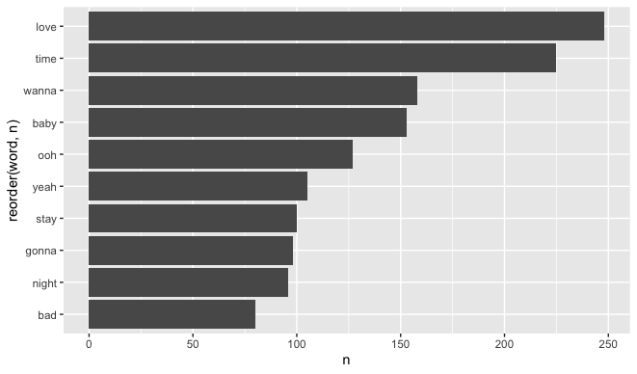
Step 4: Visualize
https://pollev.com/vsovero
ggplot(data=tidy_lyrics_top_ten, mapping=aes(x= reorder(word, n), y=n))+
geom_col() +
coord_flip()

Slide 10
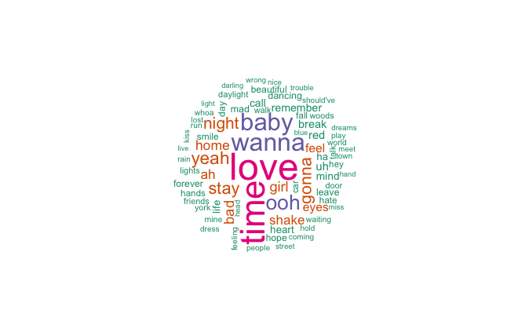
Word Clouds
Word clouds are another method of visualizing word frequencies
the size and color of the word denote relative frequency

Slide 11
Setup for Word Clouds
Create a frequency table of word counts using count()
sort the counts in descending order using arrange(desc())
keep the top 75 words for the word cloud using slice_head()
tidy_lyrics_no_stop %>%
count(word) %>%
arrange(desc( n)) %>%
slice_head(n=75)

Slide 12
Word Clouds
tidy_lyrics_no_stop %>%
count(word) %>%
arrange(desc( n)) %>%
slice_head(n=75) %>%
with(wordcloud(words =word, freq=n))
we pass the frequency table over to the wordcloud() function using pipes and with()
wordcloud() arguments:
words: name of the variable that contains the words you want to visualize
freq: name of the variable that records the frequency of each word

Slide 13
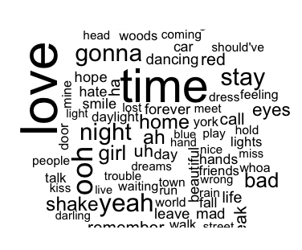
Word Clouds
tidy_lyrics_no_stop %>%
count(word) %>%
arrange(desc( n)) %>%
slice_head(n=75) %>%
with(wordcloud(words =word, freq=n))
Output: world cloud where size represents relative frequency
Note: default is for random subset of words to be visualized when there isn’t enough space for all of the words

Slide 14
Word Clouds
tidy_lyrics_no_stop %>%
count(word) %>%
arrange(desc( n)) %>%
slice_head(n=75) %>%
with(wordcloud(words =word, freq=n,
random.order=FALSE))
we can turn off the random selection of words with the random.order argument
layout is still random

Slide 15
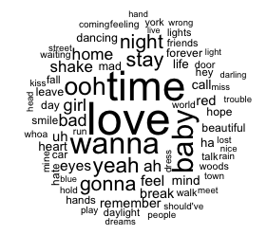
Word Cloud Adjustments: word scale
tidy_lyrics_no_stop %>%
count(word) %>%
arrange(desc( n)) %>%
slice_head(n=75) %>%
with(wordcloud(words =word, freq=n,
random.order=FALSE, scale= c(3, 0.25)))
We can adjust the relative scale of the word sizes by adding the scale argument

Slide 16
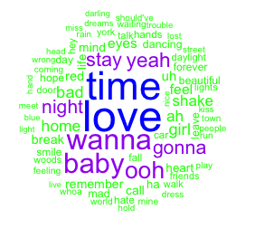
Word Cloud Adjustments: add color
tidy_lyrics_no_stop %>%
count(word) %>%
arrange(desc( n)) %>%
slice_head(n=75) %>%
with(wordcloud(words =word, freq=n,
random.order=FALSE, scale= c(3, 0.25),
colors=c('green', 'purple', 'blue')))
We can manually choose the colors using the colors argument
color order listed will be assigned to words from lowest to highest frequency
list of color names available here: http://www.stat.columbia.edu/~tzheng/files/Rcolor.pdf

Slide 17
Exercise
https://pollev.com/vsovero
tokenize the comments in the rate my professors data frame
remove stop words, plus ‘professor’, ‘class’, ‘students’, and ‘teacher’
create a word cloud of the top 75 words, use the following color scale: purple, green, yellow, red

Slide 18
Word Cloud Adjustments: add color
tidy_lyrics_no_stop %>%
count(word) %>%
arrange(desc( n)) %>%
slice_head(n=75) %>%
with(wordcloud(words =word, freq=n,
random.order=FALSE, scale= c(3, 0.25),
colors= brewer.pal(4,"Dark2")))
We can choose a color palette using brewer.pal() from the RColorBrewer package
Arguments:
number of colors (4)
name of palette (Dark2)
Palette names available here: https://r-graph-gallery.com/38-rcolorbrewers-palettes.html

Slide 19
Next: Sentiment Analysis
What else can we do besides word/stem frequency?
When you read a text, you can infer whether it expresses a positive or negative emotion:
”I’m so happy!”
“I feel sad.”
We can use the tools of text mining to analyze the emotional content of text

Slide 20
Sentiment Analysis
Our approach:
tokenize into single words
evaluate sentiment scores of individual words
summarize: add up the individual sentiment scores for each word in the text
visualize

Slide 21
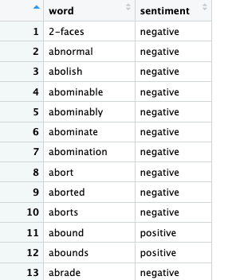
Sentiment Lexicons
A sentiment lexicon (dictionary) contain many English words and their associated sentiment
You can load sentiment lexicons using the get_sentiments() function from the tidytext package
the bing lexicon assigns words as negative or positive
bing_lexicon<-get_sentiments(lexicon="bing")

Slide 22
Downside of single word sentiment analysis
We will misclassify a sentiment when the word is paired with a negative:
“I’m not happy!”
“I don’t feel sad”

Slide 23
Ok, let’s analyze Taylor Swifts Lyrics
We already have the tokenized version of her lyrics
We are going to perform an inner join with the bing lexicon (keep words in Taylor Swift lyrics that can be matched to a sentiment)
tidy_lyrics_bing<- inner_join(x=tidy_lyrics, y=bing_lexicon)

Slide 24
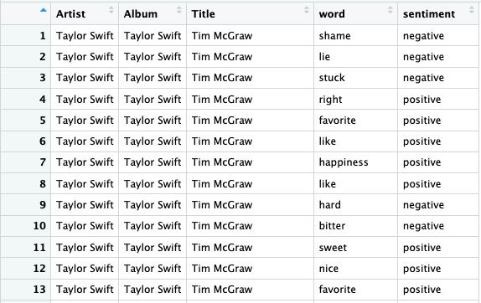
Bing Sentiments
tidy_lyrics_bing<- inner_join(x=tidy_lyrics, y=bing_lexicon)
Now we have a sentiment column that we can use to analyze Taylor Swift’s lyrics

Slide 25
Top 10 Positive Words
Filter for words with a positive sentiment
count the frequency of each positive word
sort in descending order
keep the top 10
bing_positive_count <- tidy_lyrics_bing%>%
filter(sentiment=="positive") %>%
count(word) %>%
arrange(desc( n)) %>%
slice_head(n=10)

Slide 26
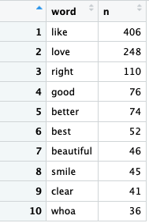
Top 10 Positive Words
bing_positive_count <- tidy_lyrics_bing%>%
filter(sentiment=="positive") %>%
count(word) %>%
arrange(desc( n)) %>%
slice_head(n=10)
Because we didn’t filter out stop words, ”like” has surpassed “love” on our top ten list

Slide 27
Class Exercise
https://pollev.com/vsovero
use the tidy rmp data (don’t remove stop words)
join with the bing lexicon, keep matches
Make a list of the top 10 negative words used in the rmp comments

Slide 28
Top 10 words with sentiment
Of the words that have a positive or negative sentiment, what are the most frequent in Taylor Swift’s lyrics?
To keep the sentiment information in our frequency table, we have to add it as an argument in the count() function
bing_count <- tidy_lyrics_bing%>%
count(word, sentiment) %>%
arrange(desc( n)) %>%
slice_head(n=10)

Slide 29
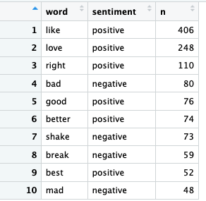
Top 10 words with sentiment
bing_word_count <- tidy_lyrics_bing%>%
count(word, sentiment) %>%
arrange(desc( n)) %>%
slice_head(n=10)
I guess “shake it off” is a negative sentiment?

Slide 30
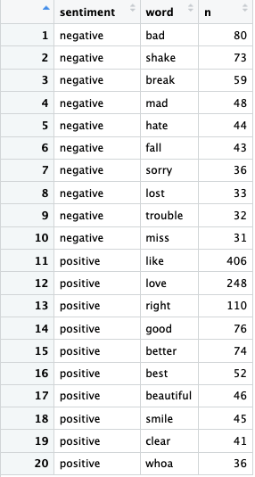
Top 10 words for each sentiment (single table)
bing_word_count <- tidy_lyrics_bing%>%
group_by(sentiment) %>%
count(word, sentiment) %>%
arrange(desc( n)) %>%
slice_head(n=10)

Slide 31
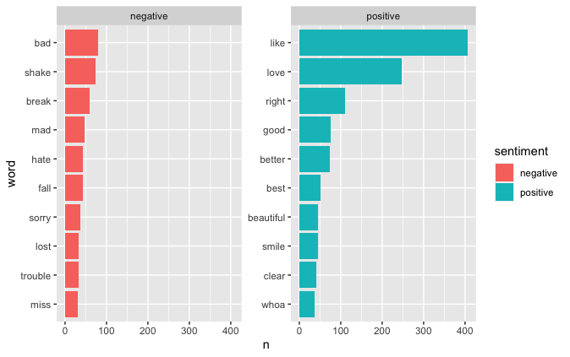
Top 10 words for each sentiment
ggplot(mapping=aes(x=n, y=word))+
geom_col(aes(fill=sentiment))+
facet_wrap (~sentiment, scales = "free_y")

Slide 32
Class Exercise
https://pollev.com/vsovero
Make a top 10 list of the most frequent words with sentiment for the rmp comments. How many are positive?

Slide 33
Top sentiments
I’m going to take a wild guess here, but Taylor Swift probably uses more words with positive sentiments versus negative sentiments
Let’s check: we will count the frequency of the sentiment
bing_sentiment_count <- tidy_lyrics_bing%>%
count(sentiment) %>%
arrange(desc( n))

Slide 34

Top sentiments
bing_sentiment_count <- tidy_lyrics_bing%>%
count(sentiment) %>%
arrange(desc( n))
More words with positive sentiments, but still a surprisingly number of negative words

Slide 35
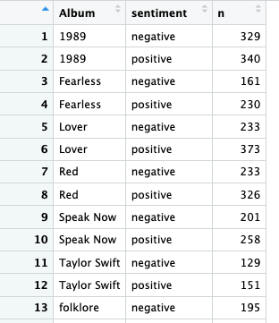
Sentiment by Album
We can also count the number of positive and negative sentiment words by Album
bing_album_sentiment <- tidy_lyrics_bing%>%
group_by(Album)%>%
count(sentiment) %>%
arrange(Album, sentiment)

Slide 36
Class Exercise
count the number of positive and negative sentiment words by student_star
What is the lowest star rating that has more positive than negative words?

Slide 37
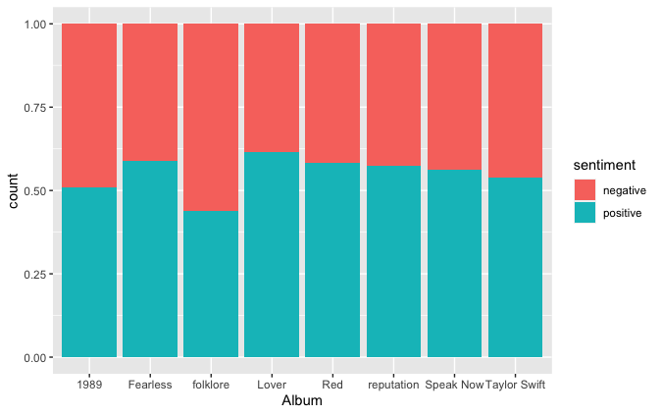
Sentiments by Album
ggplot(data=tidy_lyrics_bing,
mapping=aes(x=Album))+
geom_bar(aes(fill=sentiment), position='fill')
Let’s create a bar chart of sentiments by album
We get proportions instead of counts with the position=‘fill’ argument

Slide 38

Sentiments by Album
ggplot(data=tidy_lyrics_bing,
mapping=aes(x=Album))+
geom_bar(aes(fill=sentiment), position='fill’ )+
geom_hline(yintercept=.5)
We can add a reference line at .5 to denote the even split of positive/negative sentiments
makes it easier to see that folklore was more negative than positive, and 1989 was almost evenly split

Slide 39
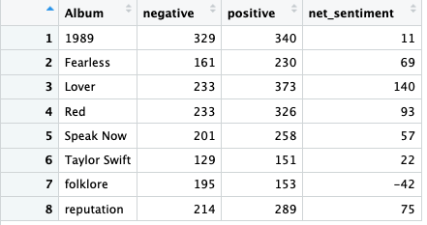
Net Sentiment
We can also calculate the net sentiment of an Album by comparing the total number of positive words to the total number of negative words:
net sentiment=#positive-#negative

Slide 40
Net Sentiment by Album
We already have the count the number of positive and negative sentiment words by Album
bing_album_sentiment <- tidy_lyrics_bing%>%
group_by(Album)%>%
count(sentiment) %>%
arrange(Album, sentiment)

Slide 41
Net Sentiment by Album
Next, we use pivot_wider() to create columns for the positive sentiment word count and the negative sentiment word count
Arguments:
The column to take the variable names from
The column to take values from
bing_album_sentiment_wider<- bing_album_sentiment %>%
pivot_wider(names_from =sentiment,
values_from =n)

Slide 42
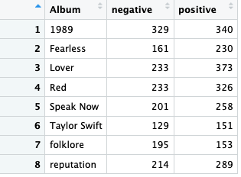
pivot_wider()
bing_album_sentiment_wider<- bing_album_sentiment %>%
pivot_wider(names_from =sentiment, values_from =n)

Slide 43
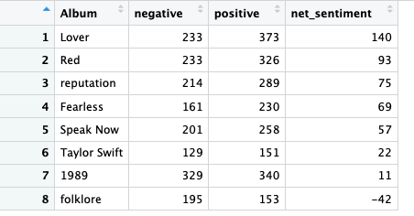
Net Sentiment by Album
Last step: create a variable that calculates the net sentiment
Bonus: sort the albums by net sentiment (most to least positive)
bing_album_net_sentiment<-bing_album_sentiment_wider%>%
mutate(net_sentiment=positive-negative)%>%
arrange(desc(net_sentiment))

Slide 44
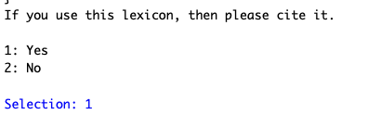
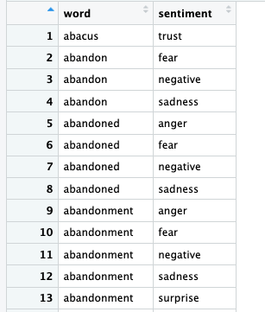
Sentiment Lexicons
nrc_lexicon<-get_sentiments(lexicon="nrc")
the nrc lexicon categorizes words into ten emotions:
positive
negative
anger
fear
joy
disgust
anticipation
surprise
trust
sadness
Note: there is an additional step when loading this lexicon (you have to type “1” when prompted in the console)

Slide 45
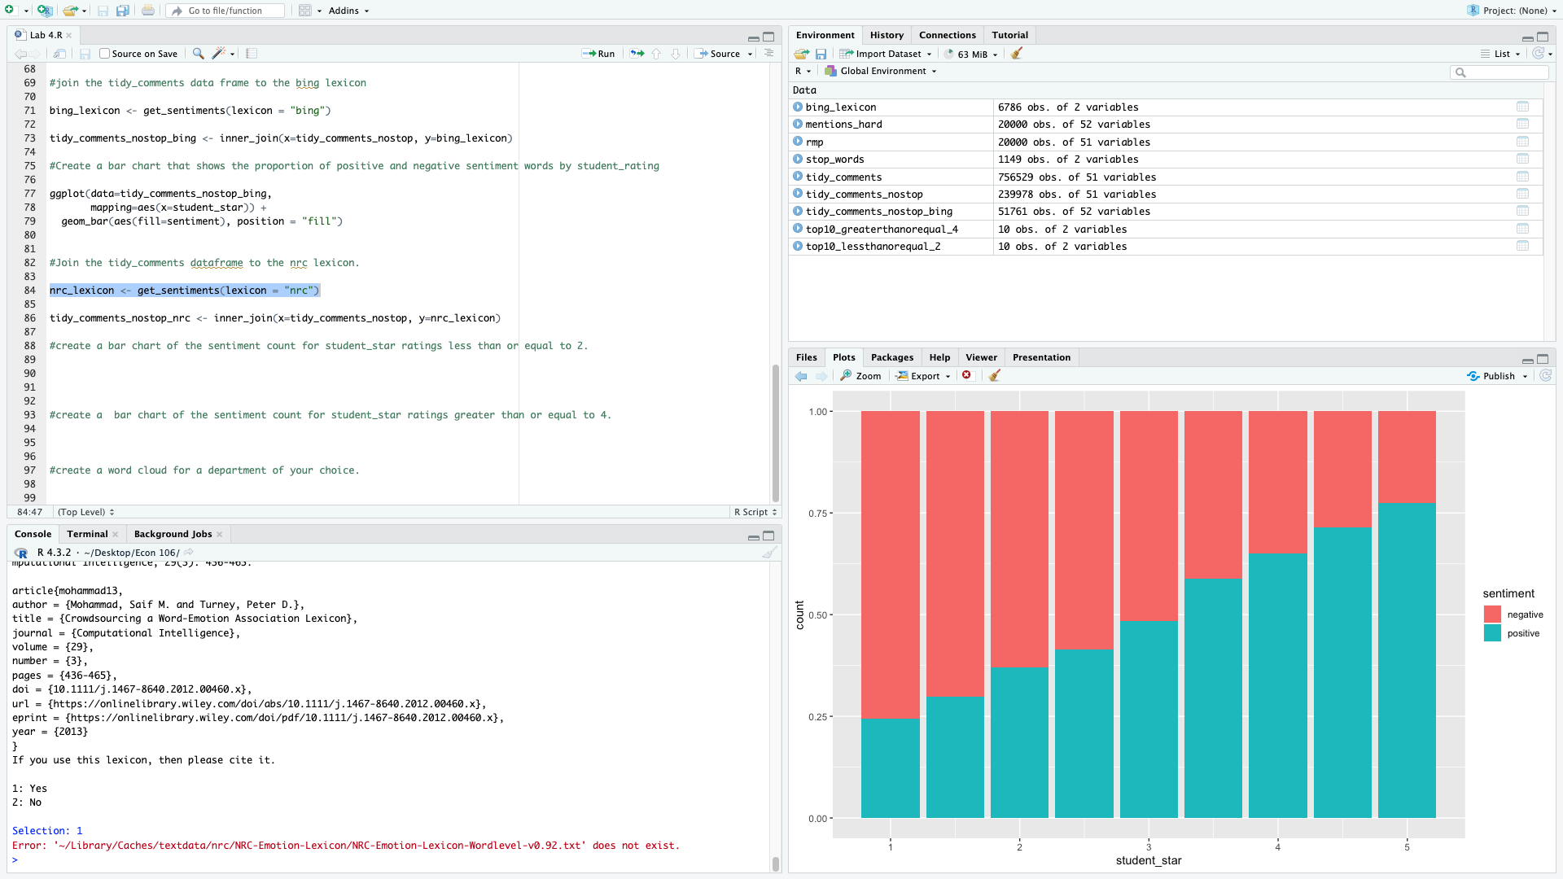
NRC Lexicon loading issue
some of you might see this error pop up
If that happens, type the following into your console window:
textdata::lexicon_nrc(delete=TRUE) textdata::lexicon_nrc()

Slide 46
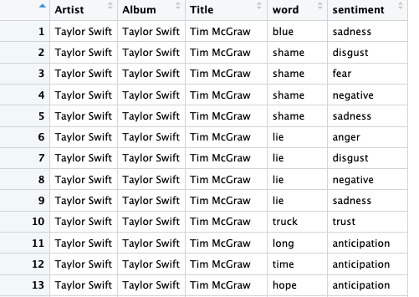
Other Sentiments
tidy_lyrics_nrc<-
inner_join(x=tidy_lyrics, y=nrc_lexicon)
Let’s use the nrc lexicon to assign an emotion to the words in Taylor Swift’s songs
Note: some words are associated with more than one emotion (you will get a warning about many-to-many matches in R)

Slide 47
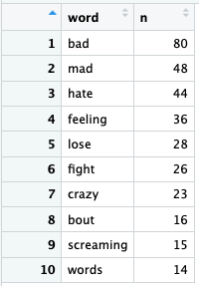
Top 10 Anger Words
nrc_anger_count <- tidy_lyrics_nrc%>%
filter(sentiment=="anger") %>%
count(word) %>%
arrange(desc( n)) %>%
slice_head(n=10)

Slide 48
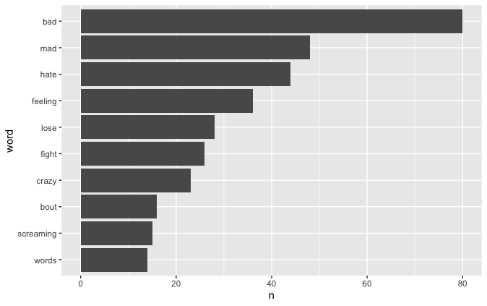
Top 10 Anger Words
ggplot(data= nrc_anger_count,
mapping=aes(x= reorder(word, n), y=n))+
geom_col()+
coord_flip()

